Slide 1
Plant-water relations
February 19, 2019

Slide 2
What do plants use water for?

Slide 3
How does water availability change in natural environments?

Slide 4
Water availability is not just about rainfall
Lubbock averages ~500 mm of rainfall a year.
Why might this have a different effect on different regions?

Slide 5
Reminder: Plants take up water in soil
How much water in the soil is actually available to plants?

Slide 6
Soil water content
Water availability to plants depends on:
Soil structure
Organic matter holds more water
Density of vegetation cover
Evaporation
Potential gradients
Location of ground water table

Slide 7
Wilting point and field capacity
Wilting point
Point at which water is no longer available to plants
Not 0% water
Dependent on soil texture
Field capacity
Point at which soil can hold no more water

Slide 8
Pardossi et al. (2009)

Slide 9
Some definitions
Water potential: potential for water to move from one area to another (pressure units; e.g., Pa)
Expressed as tension relative to pure water (so is negative)
Water conductivity: speed at which water moves from one area to another (speed units; e.g., s-1)
Water resistance: inverse of conductance
P50: potential at which 50% loss of conductivity is observed due to embolism

Slide 10
Plant-water potential

Slide 11
Water potential
Tendency of water to move from one area to another
Denoted using the Greek letter psi (Ψ)

Slide 12
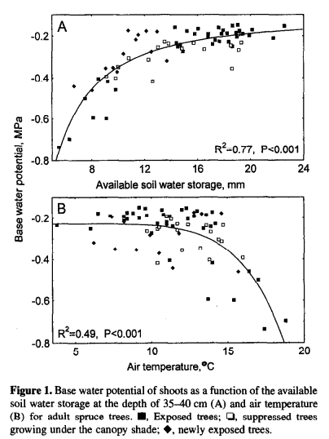
Equilibrium water potential can be used as a proxy for soil water potential
Can measure this when stomates are closed (e.g., pre-dawn)
Sellin (1999)

Slide 13
Plants can regulate water potential!

Slide 14
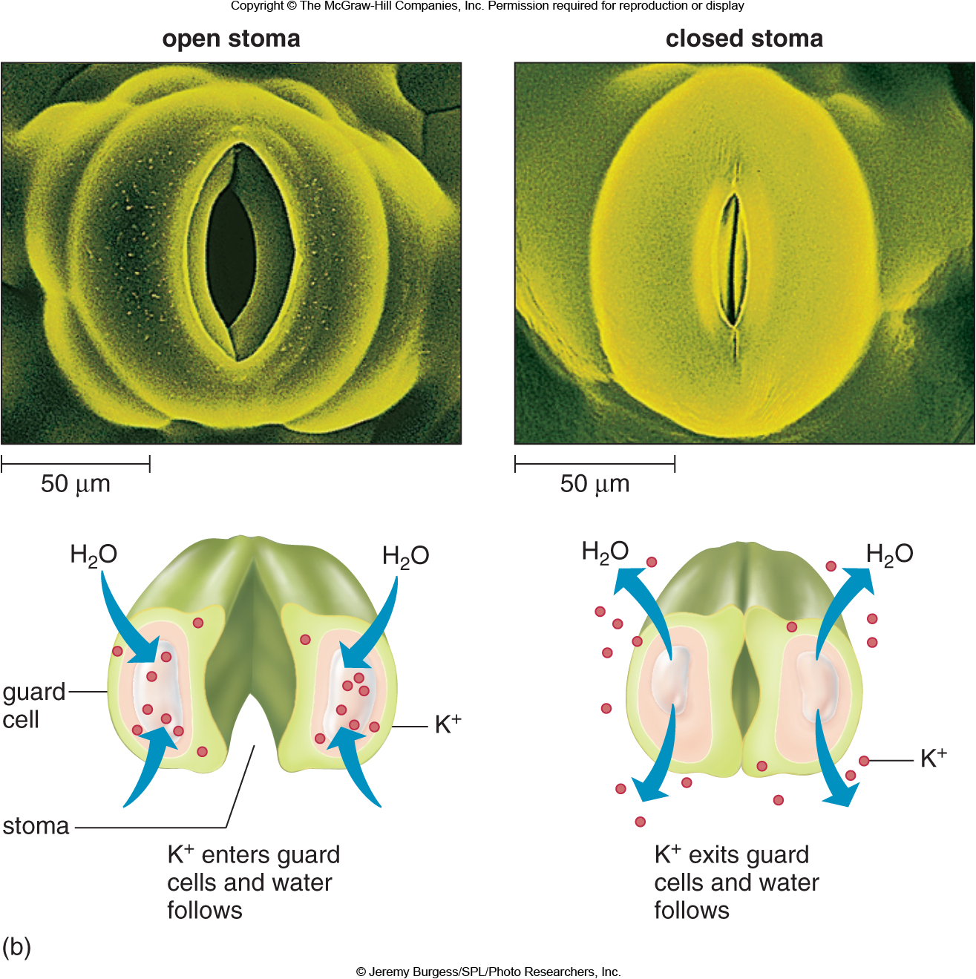
Water potential regulation: Guard cells
Create open or closed stomata by changing turgor pressure

Slide 15
Plant drought strategies
Pinon pine (Pinus edulis)
Juniper (Juniperus monosperma)
McDowell et al. (2008). Mechanisms of plant survival and mortality during drought: Why do some plants survive and others succumb. New Phytologist 178: 719-739.

Slide 16
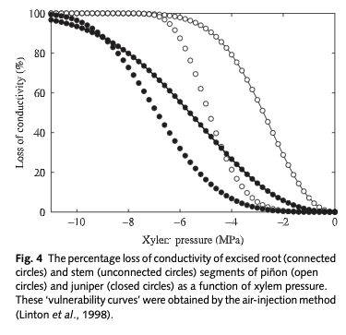
Pinus edulis
Water potentials can be used to examine different plant strategies
Juniperus
monosperma
McDowell et al. (2008)

Slide 17
Isohydry
Isohydric species are sensitive to changes in water availability, quickly closing their stomata in response to drought
Drought avoiders
Maintain high Ψ
Anisohydric species tend to respond more slowly to drought
Drought tolerators
Tolerate low Ψ

Slide 18
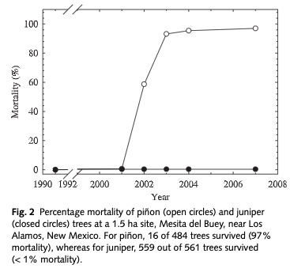
The poor Pinon!
What do you think happened?
McDowell et al. (2008)

Slide 19
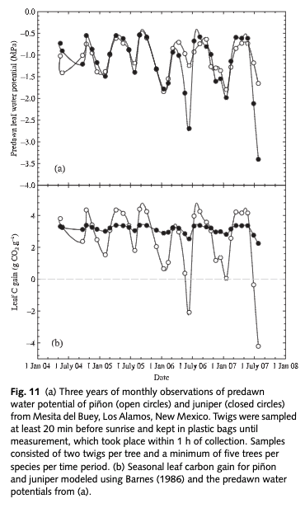
McDowell et al. (2008)

Slide 20
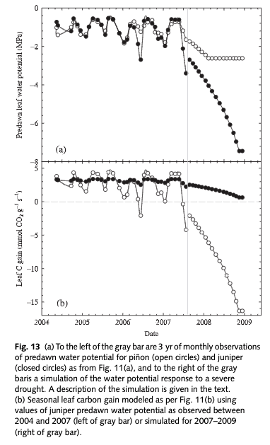
McDowell et al. (2008)

Slide 21
A matter of time and duration

Slide 22
McDowell et al. (2008)

Slide 23
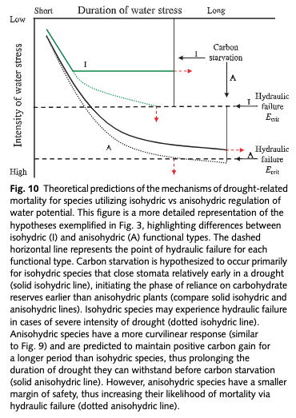
McDowell et al. (2008)

Slide 24
How would you expect anisohydric versus isohydric species to differ morphologically?

Slide 25
Other drought adaptation traits: plants in your own backyard!

Slide 26
Other drought adaptation traits: plants in your own backyard!
Bouteloua gracilis
Prosopis glandulosa
Opuntia phaecantha

Slide 27
Interactions with other conditions in the field: Chaves et al. (2002)

